Slide 1
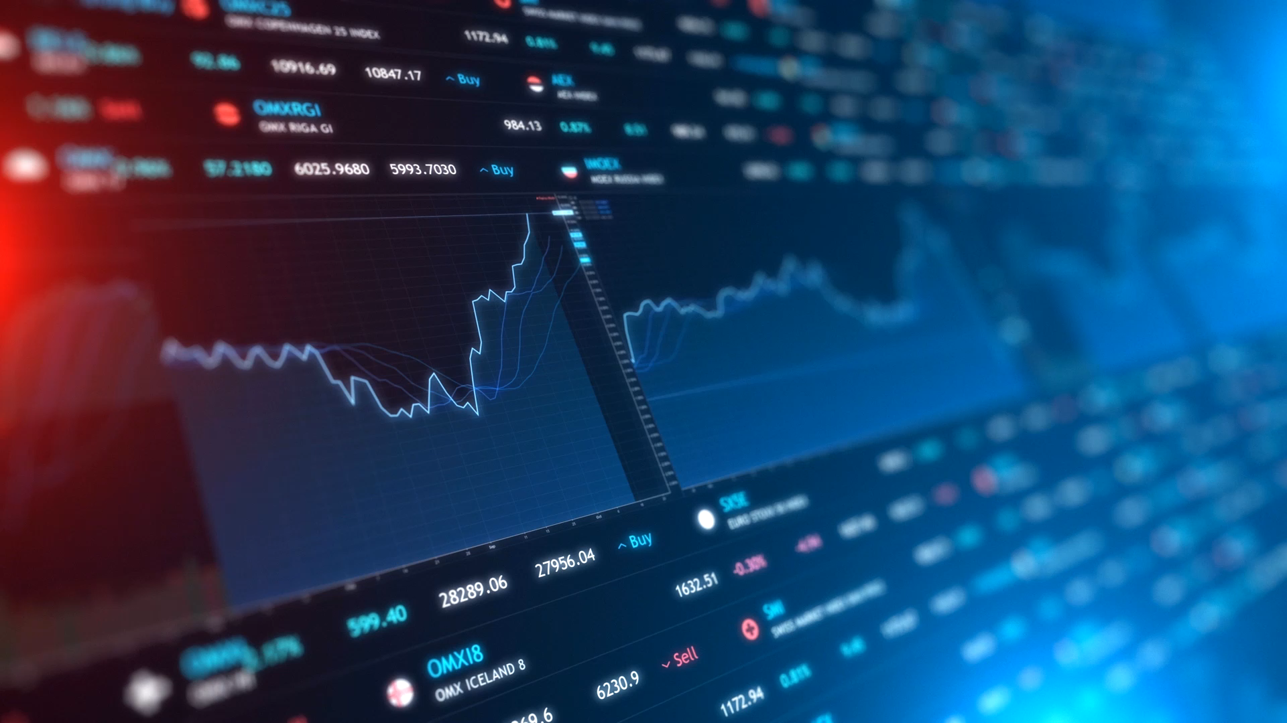
AI for Trading System
DataH & The Innovation Lab

Slide 2
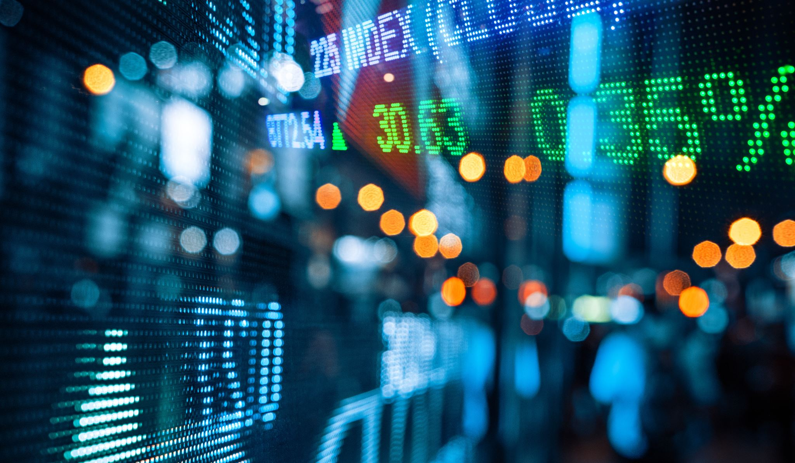





The Team
Siha Uddin
Zixin Wang
Wentao Ju
Frédéric Pelletier
Nazim Benguettat

Slide 3

The challenge
How can we transform data into automated investment decisions

Slide 4

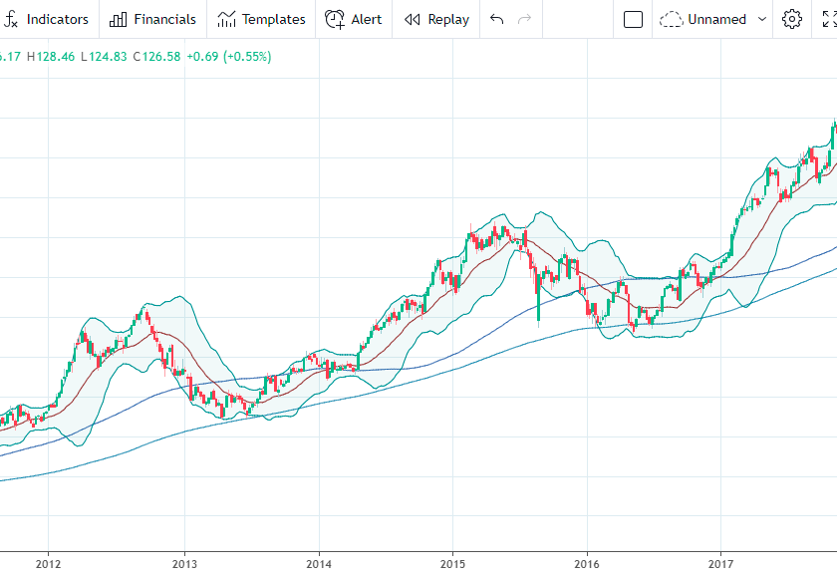
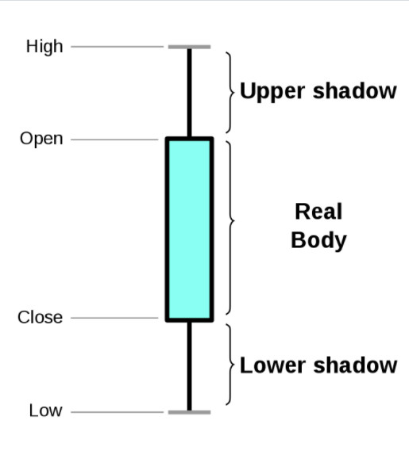
Understanding the Basics: Financial Charts
Stock chart visualization
Candlestick Information

Slide 5
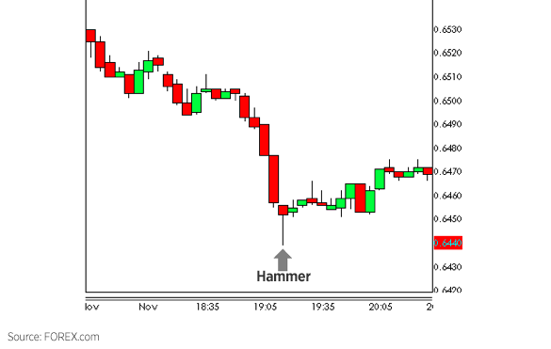
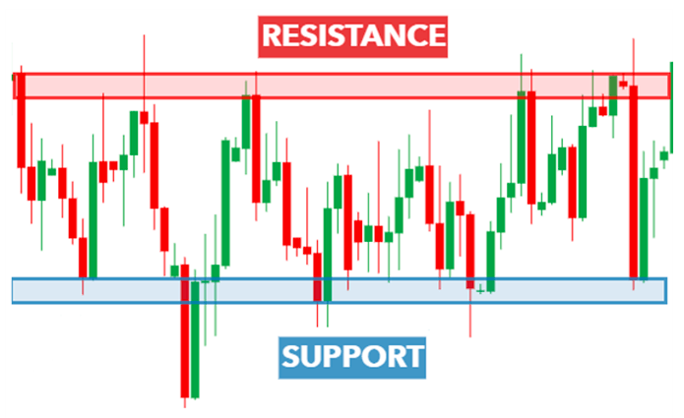
Understanding the Basics: Charts Patterns
Hammer
Support & Resistance

Slide 6
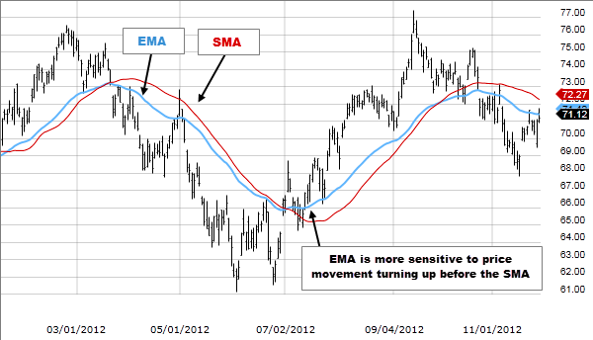
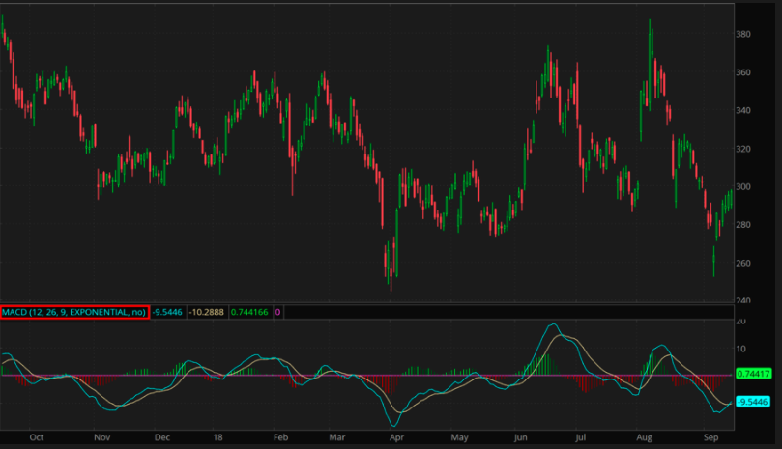
Understanding the Basics: Charts Indicators
Simple Moving Average & Exponential Moving Average
MACD

Slide 7
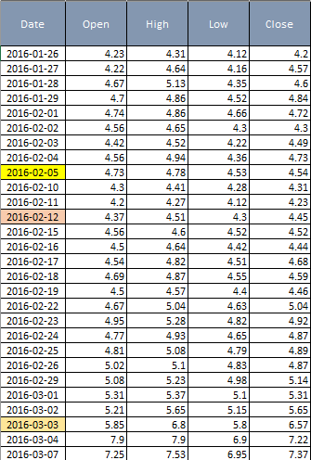

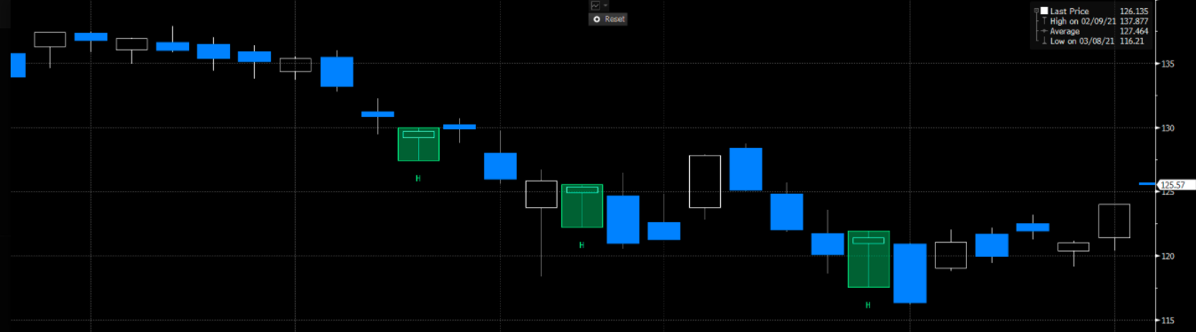
Using the Data to Build Hammer Mathematical Model
Parameters
➔
↓
Hammer Pattern Detection
Daily Stock Data

Slide 8
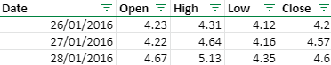
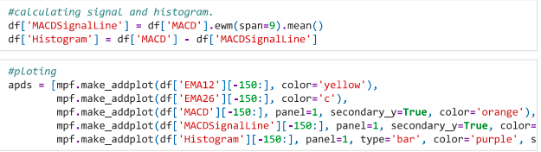
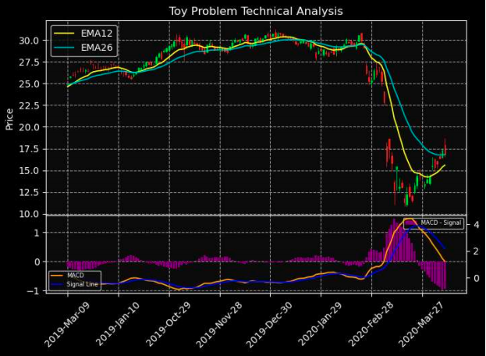
Using the Data to Build MACD Model
Daily Stock Data
↓
Python Code
↓
Indicator Graphing

Slide 9
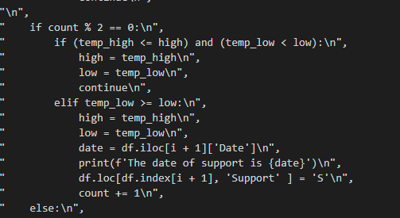
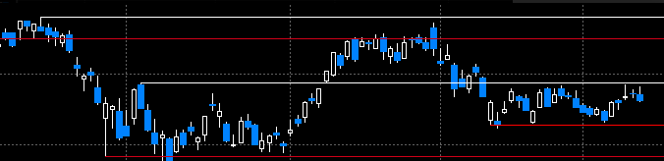
Using the Data to Find Support & Resistance
Daily Stock Data
↓
Python Code
↓
↓
Support & Resistance Graphing

